Slide 1

Decision Tree
Dr. Linrui Zhang
University of Central Missouri

Slide 2







What is a decision tree ?
Predication
Age<15 0 1
Is Male 1 1
age < 15
Yes
No
Feature1 Feature2 Label
is male
 | Age<15 | Is Male | Play Game
Grandpa | 0 | 1 | 0
Grandma | 0 | 0 | 0
Sister | 1 | 0 | 0
Mom | 0 | 0 | 0
Me | 1 | 1 | 1
Yes
No

Slide 3
What is a decision tree ?
Which feature to select?
When to stop?
age < 15
Yes
No
is male
Yes
No

Slide 4
Entropy
The entropy of S, denoted Entropy(S) is defined as follows:
Entropy(S) = -P₀log₂P₀ –P₁log₂P₁

Slide 5
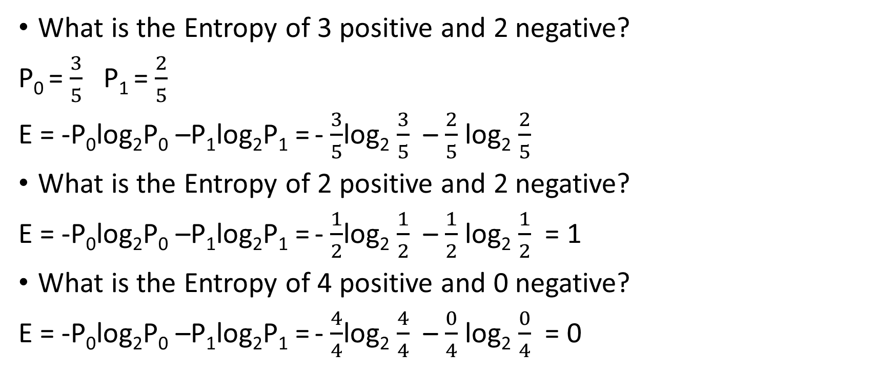
Example
What is the Entropy of 3 positive and 2 negative?
P₀ = $\frac{3}{5}$ P₁ = $\frac{2}{5}$
E = -P₀log₂P₀ –P₁log₂P₁ = - $\frac{3}{5}$log₂ $\frac{3}{5}$ – $\frac{2}{5}$ log₂ $\frac{2}{5}$
What is the Entropy of 2 positive and 2 negative?
E = -P₀log₂P₀ –P₁log₂P₁ = - $\frac{1}{2}$log₂ $\frac{1}{2}$ – $\frac{1}{2}$ log₂ $\frac{1}{2}$ = 1
What is the Entropy of 4 positive and 0 negative?
E = -P₀log₂P₀ –P₁log₂P₁ = - $\frac{4}{4}$log₂ $\frac{4}{4}$ – $\frac{0}{4}$ log₂ $\frac{0}{4}$ = 0

Slide 6
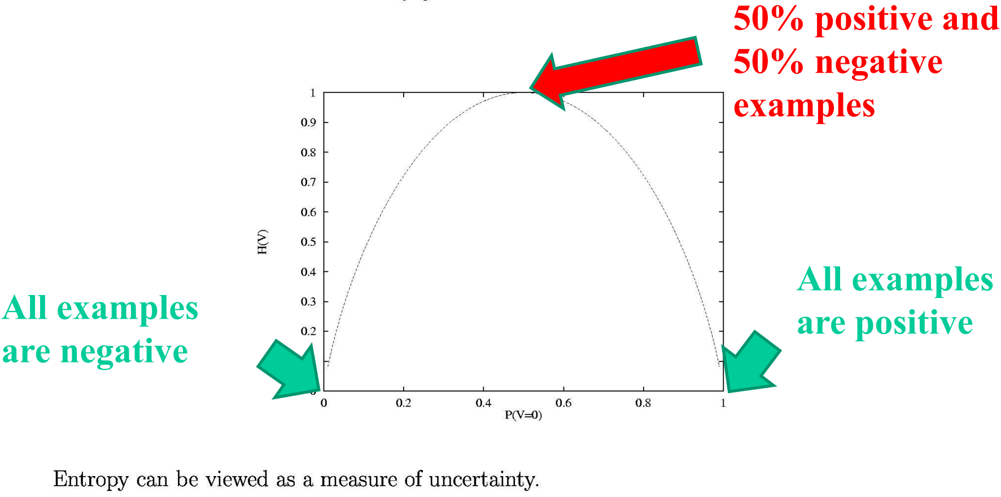
Entropy

Slide 7
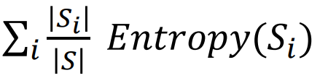
Information Gain
What will happen if an attribute A is selected?
If A has k values, the instances S will be divided into subsets: S₁, …, S_{k}.
After A is tested: the expected entropy is
Before A is tested: Entropy(S)
Information gain:
ID3: select the attribute that can maximize Gain(S,A), until every leaf is pure.

Slide 8
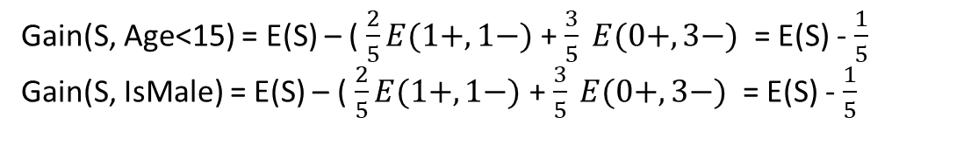
Information Gain
 | Age<15 | Is Male | Play Game
Grandpa | 0 | 1 | 0
Grandma | 0 | 0 | 0
Sister | 1 | 0 | 0
Mom | 0 | 0 | 0
Me | 1 | 1 | 1
Let’s look back and calculate the information gain of “Age<15” and “I sMale”
S
S
Age>15
Is Male
Is Not Male
Age<15
1+,1-
3-
1+,1-
3-
Gain(S, Age<15) = E(S) – ( $\frac{2}{5}E(1+,1−)$ + $\frac{3}{5} E(0+, 3−)$ = E(S) - $\frac{1}{5}$
Gain(S, IsMale) = E(S) – ( $\frac{2}{5}E(1+,1−)$ + $\frac{3}{5} E(0+, 3−)$ = E(S) - $\frac{1}{5}$

Slide 9
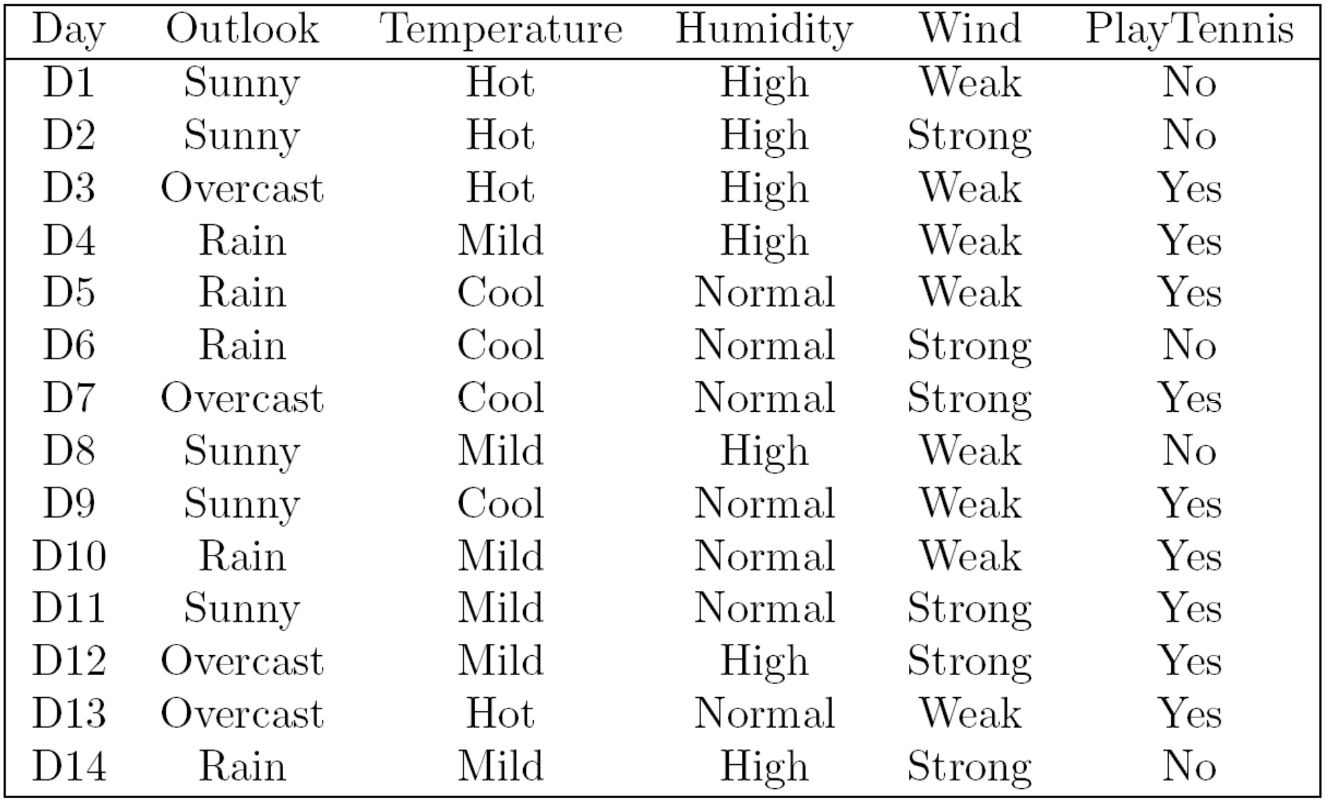
Now, Let’s look at a complex example
When do I play tennis?

Slide 10
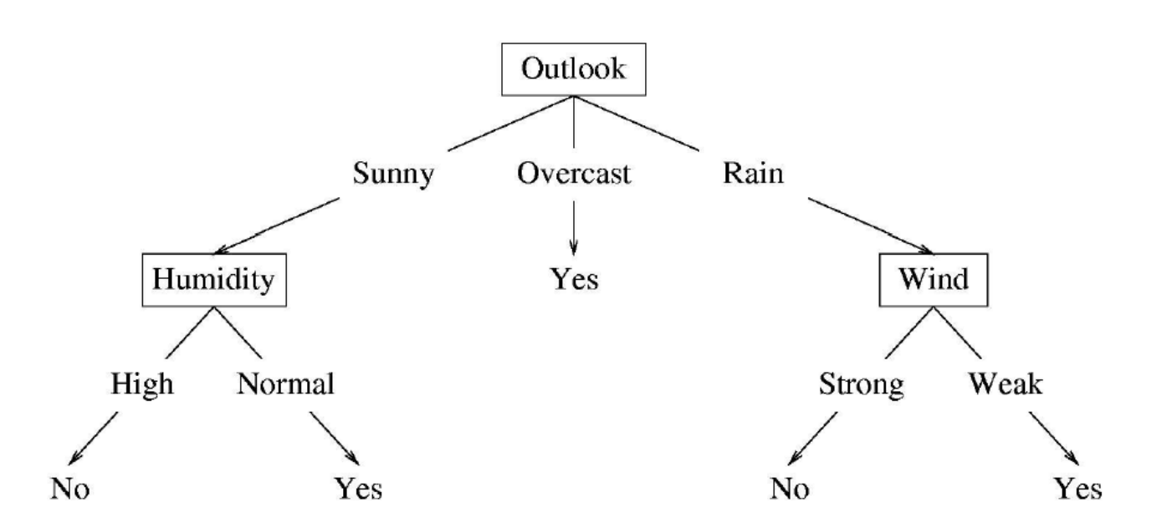
Construct the decision tree using ID3 algorithm
It’s time to take notes!

Slide 11
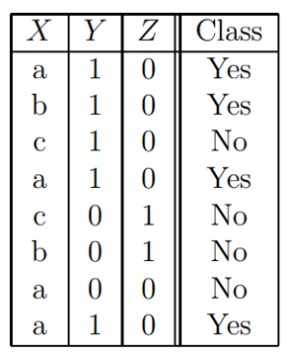
Exercise 1
You are given the following Dataset S;
What is the Entropy of the Dataset S?
What is the Entropy of the Attribute X?
You are given that :
Gain(S,X) = 0.344; Gain(S, Y) = 0.2049, and Gain (S,Z) = 0.5171,
Choose the appropriate root node for the Decision Tree?

Slide 12
Exercise 1 Solution
1. The entropy of the data is 1.
2.
3. The appropriate root node is Z.

Slide 13
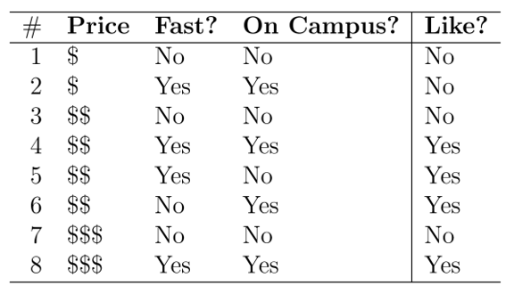
Exercise II
We wish to learn a decision tree to help students pick restaurants using three price, the location of the restaurant and the speed of service. The data for training the tree is given below, where the target concept is the column labeled “Like”.

Slide 14
Exercise II
What is the entropy of the collection of examples with respect to the target label.
Compute the information gain of the attribute Price.
Compute the information gain of the attribute Fast.

Slide 15
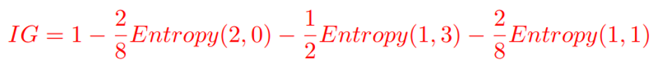
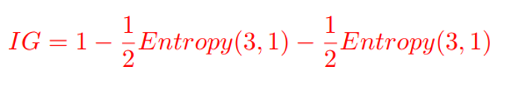
Exercise II solution
1. The entropy is 1
2.
3.

Slide 16
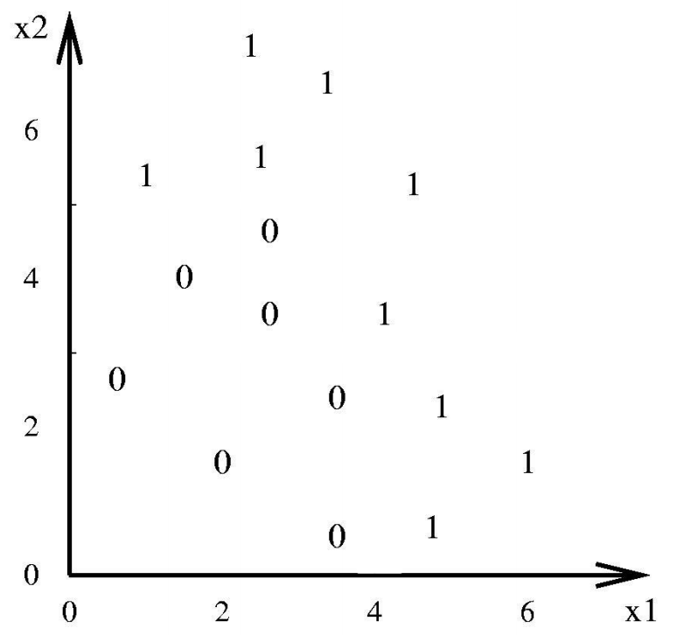
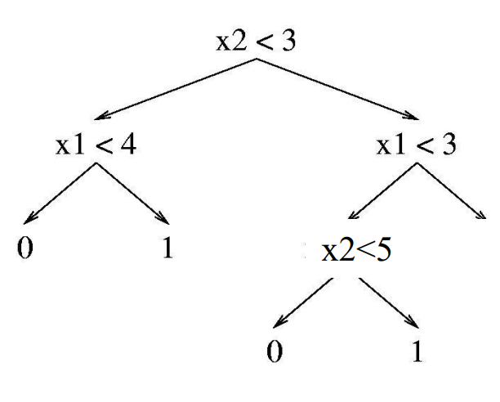
Visualize the Decision Tree
1

Slide 17
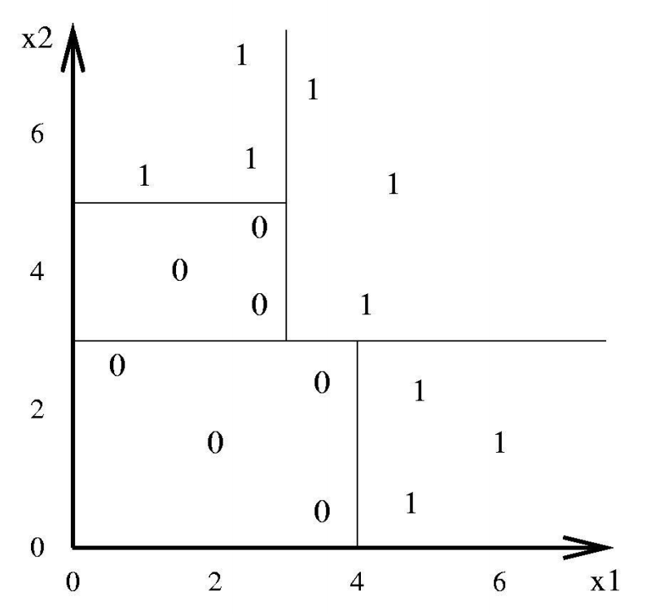
Visualize the Decision Tree

Slide 18
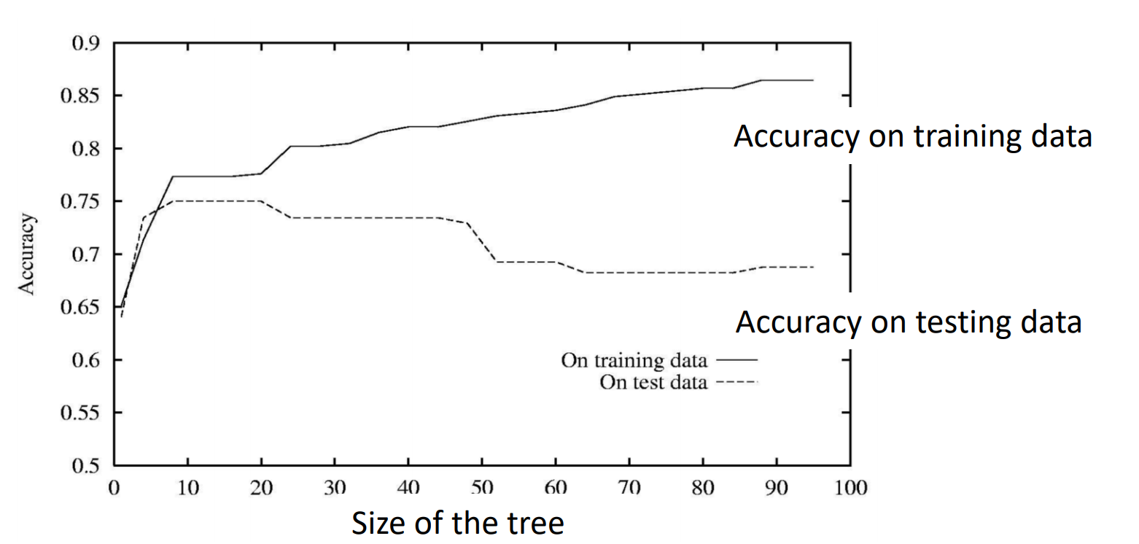
Overfitting
It happens when the tree is too large

Slide 19
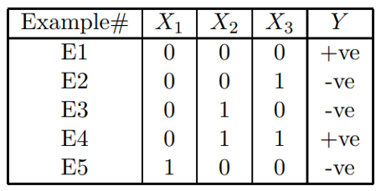
QUIZ Time
Consider the training dataset given below. In the dataset, X₁, X₂ and X₃ are the attributes and Y is the class variable.
Which attribute has the highest information gain? Justify your answer?
Given: log₂(2/3) = -0.58, log₂(1/3)=-1.58, log₂(3/5) = -0.737, log₂(2/5)=-1.322

Slide 20
log₂(2/3) = -0.58,
log₂(1/3)=-1.58,
log₂(3/5) = -0.737,
log₂(2/5)=-1.322

Slide 21
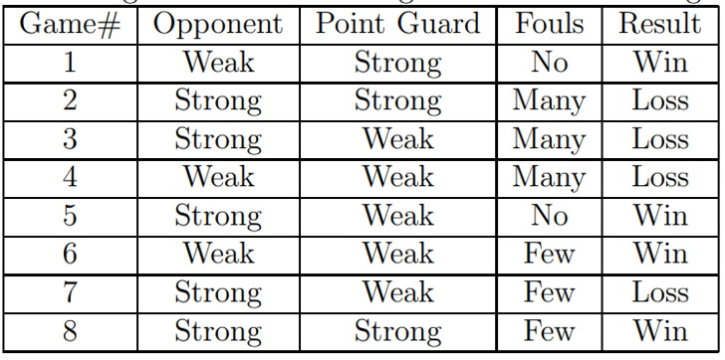
Homework
The following is data from last eight Dallas Mavericks game. Features: Opponent, Point Guard, Fouls, Results. Label: Result.
What is the entropy of the data set?
What is the information gain if you split the dataset based on the attribute Fouls.

